Slide 1
University/Classroom Management System

Slide 2
Members
Team Leader :
Arindam Chatterjee(123180703019)
Team Members :
Abhik Khan (123180703001)
Amit Das (123180703005)
Guddu Kumar (123180703034)
Under the supervision
of
DR. SUDIPTA SAHANA

Slide 3

Overview
UNIVERSITY(CLASSROOM) MANAGEMENT SYSTEM (UMS) is a flagship product of Easy Solution which covers all aspects of Universities, Colleges or Schools. UMS covers every minute aspects of a universities work flow and integrates all processes with user friendly interface. With hundreds of satisfied customers UMS is first choice of several state, governments/semi- government universities and institutions. UMS is an outcome of hard work done by our expert technical team in supervision of several renowned educationists which includes Controller of examination, faculties. UMS is a rare combination of experience and precision
UMS streamline path of information flow in organization by taking care of following departments:
Fee Department
Examination Department
Attendance
Faculty information portal
Student information portal

Slide 4

Purpose:
Drive operational efficiency.
Self-service systems with simple to use with little or no training.
Elimination of duplicate data entry processes.
Integrated with Online Application workflow with unified data model.
Monitoring and decision support system.
Automation of all the Academic / Examination / Administration operations.
Ease and accuracy of reporting

Slide 5
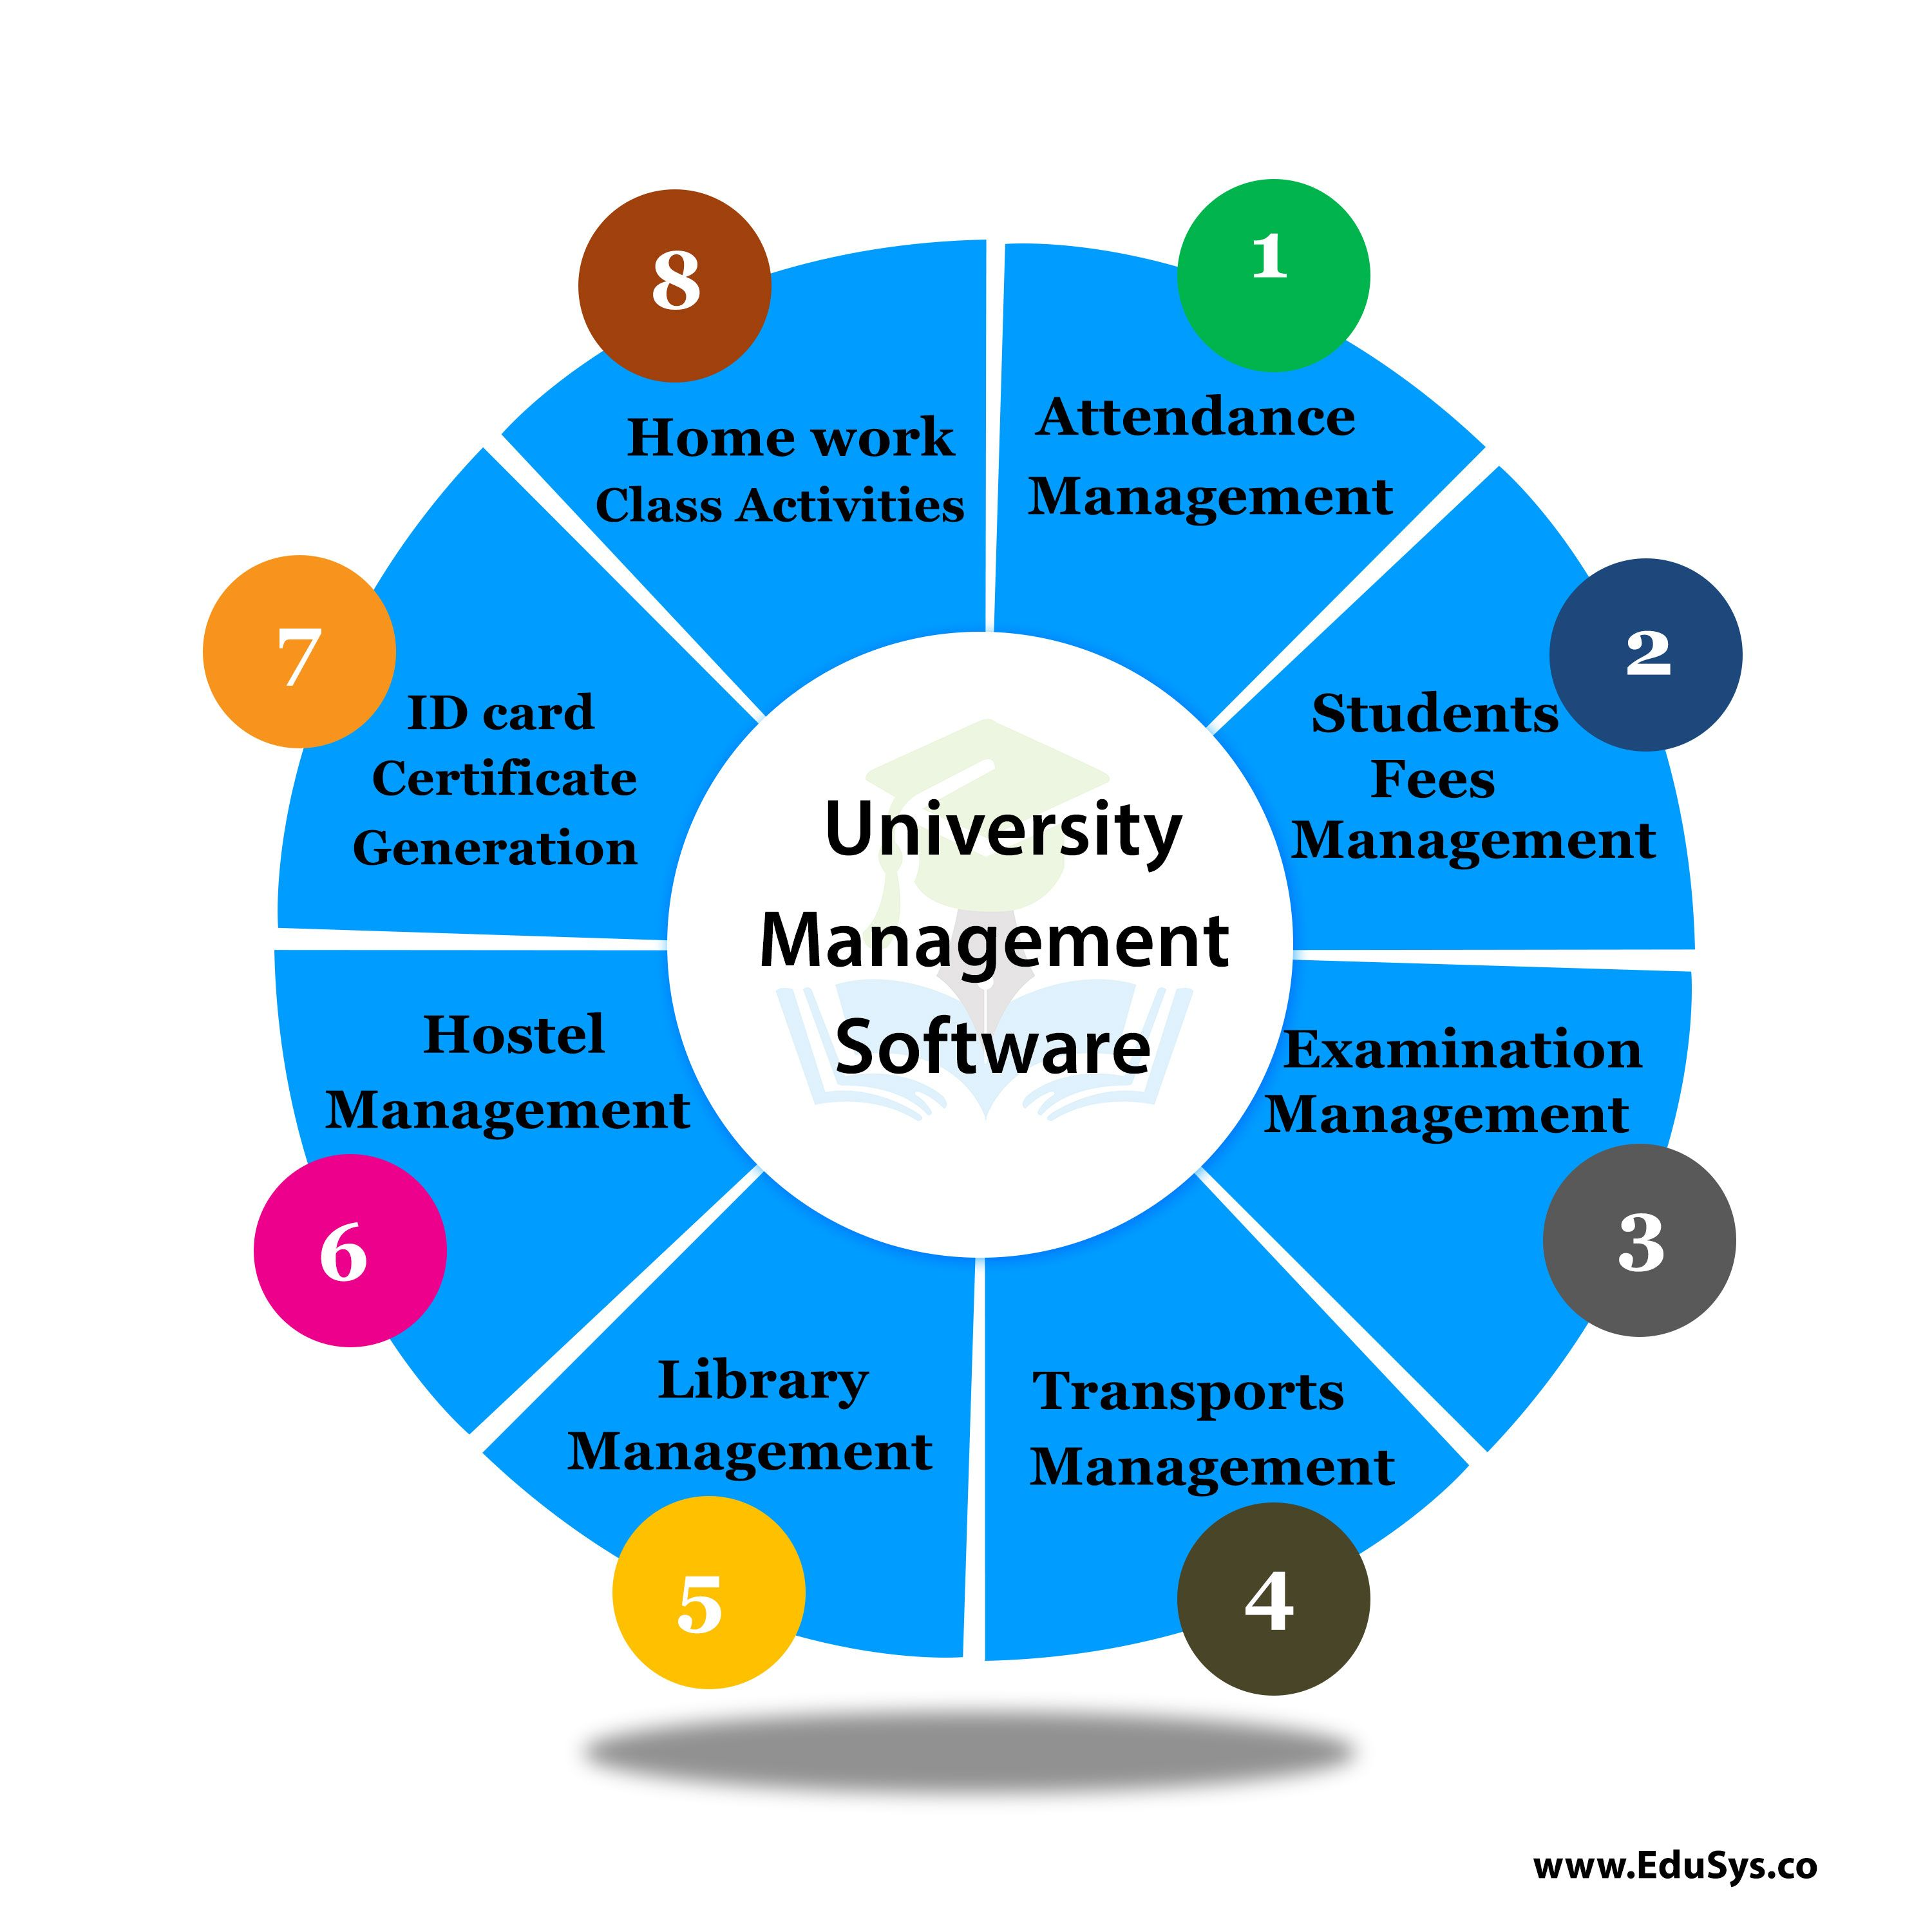
Scope
This project deals with the various functioning in College management process. The main idea is to implement a proper process to system .In our existing system contains a many operations registration, student search, fees, attendance, exam records, performance of the student etc. All these activity takeout manually by administrator.
In our model, it deals with the Operations in system. For example, when students fill the registration form the record is stored in the database. And display the details of student is perform by retrieving information from database table.

Slide 6
Data Flow diagram
College
Mgt.
Student
CMS
Login
admin
CMS

Slide 7
Data Flow Diagram
Admin
About us
Login
Home Page
Marks
Registration
Examination Details
Attendance
Student Search
Fees
Data Base

Slide 8
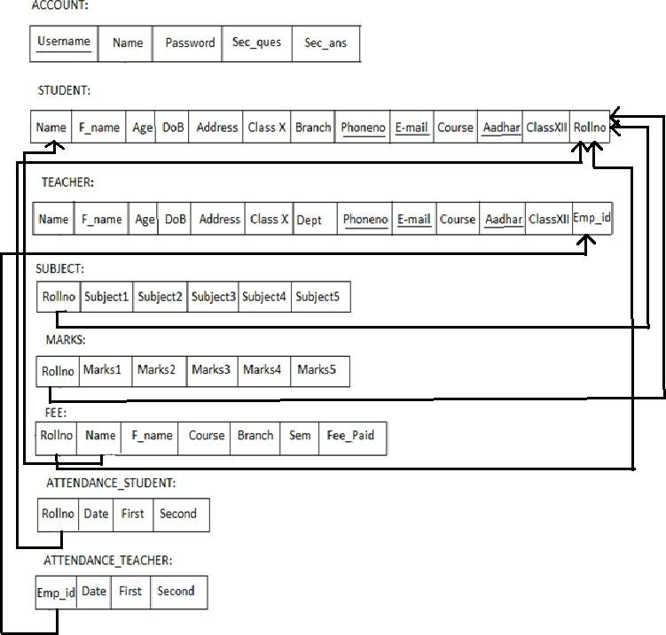
SCHEMA DIAGRAM:

Slide 9
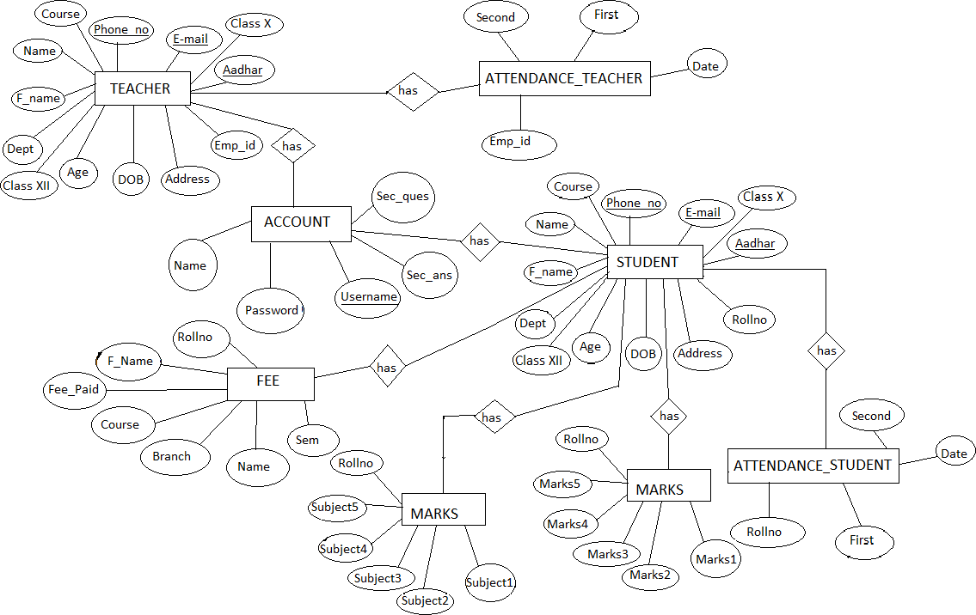
ER DIAGRAM

Slide 10
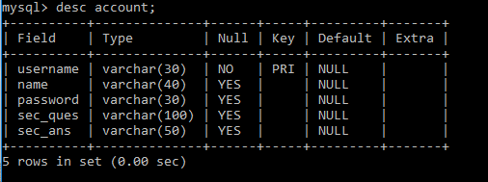
ACCOUNT TABLE
Account table consists of five attributes which are Username, Name, Password, Sec_ques, Sec_ans.Username is used as Primary key.

Slide 11
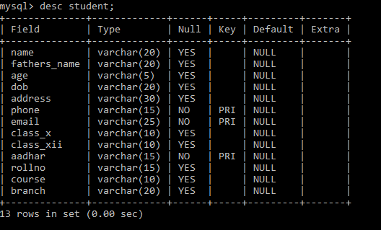
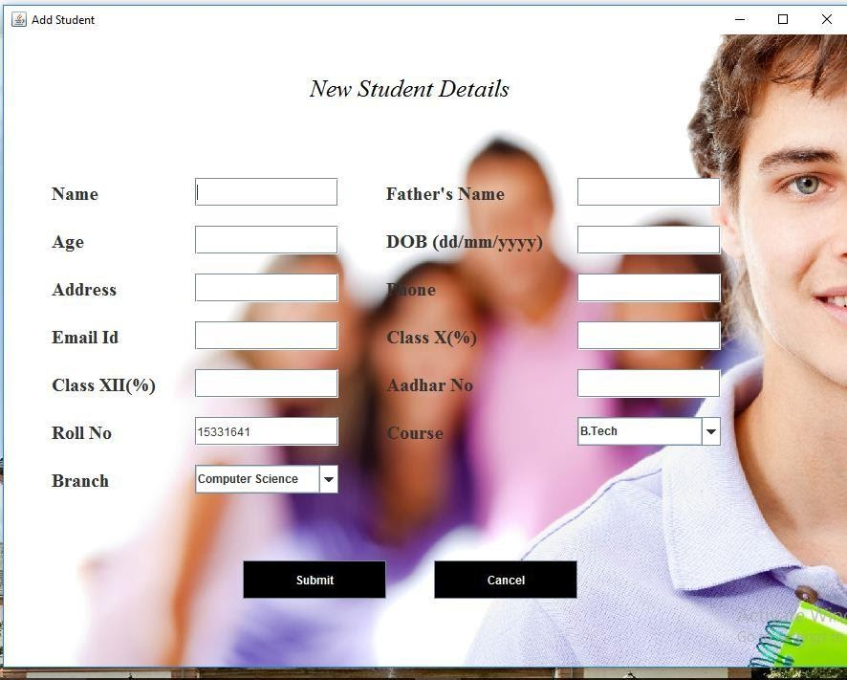
STUDENT TABLE
Student table is used to add the details of new student like Name,phoneno.,DoB,course,Branch etc...Phoneno. ,E-mail and Aadhar are used as Primary key.

Slide 12
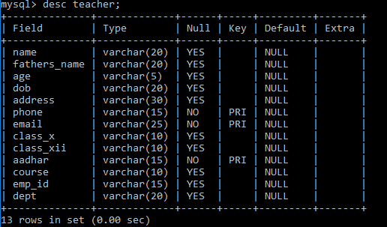
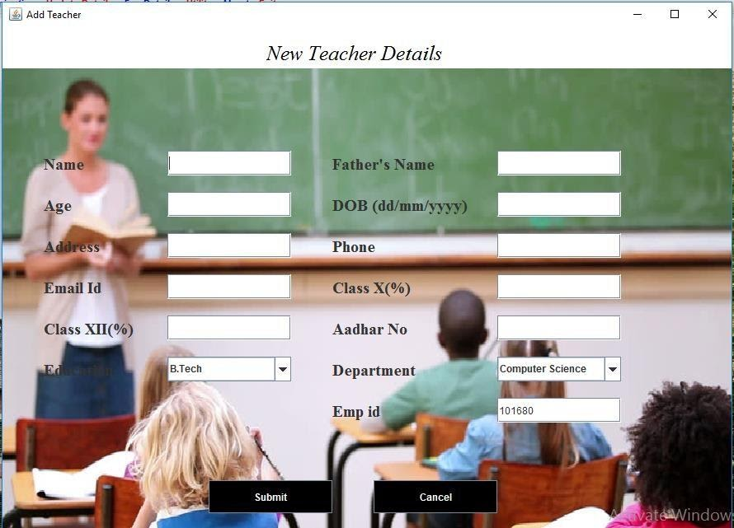
TEACHER TABLE
Teacher table is used to add the details of new student like Name, phoneno.,DoB, course,Branch etc...Phoneno. ,E-mail and Aadhar are used as Primary key.

Slide 13
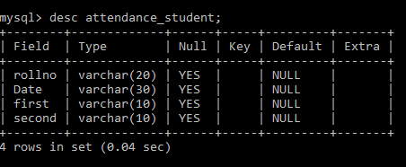
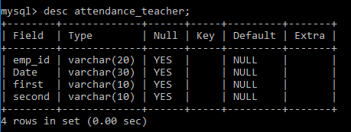
ATTENDANCE TABLE
Attendance_Student Table: Attendance_Student table is used to mark the attendance of the student day to day which as attributes like rollno,name,first and second half.
Attendance_Teachertable :Attendance_Teacher table is used to mark the attendance of the teacher day to day which as attributes like emp_id,name,first and second half.

Slide 14
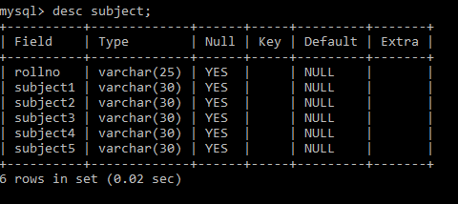
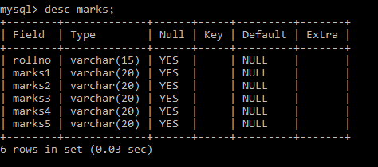
Subject And Marks Table
Subject table : Subject table is used to add thesubjects of the student in that particular sem with the attributes like rollno and five subjects.
MARKS TABLE
Marks table :Marks table is used to add the marks of the particular subjects of the student in a particular sem and the attributes used are rollno and five subject marks.

Slide 15
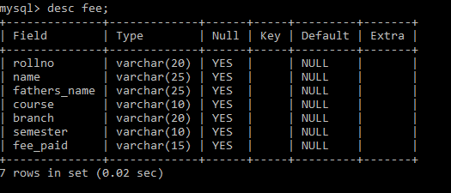
FEES TABLE
Fee table:fee table is used to pay the fee dues of the student for that particular sem and the attributes used like rollno, name, fathersname, course, branch, sem and fee_paid.

Slide 16
Software Requirements :
Operating system : Windows 10
Application server : Visual Studio Code
Front end : JAVA
Database connectivity : WAMP (MYSQL Console)

Slide 17
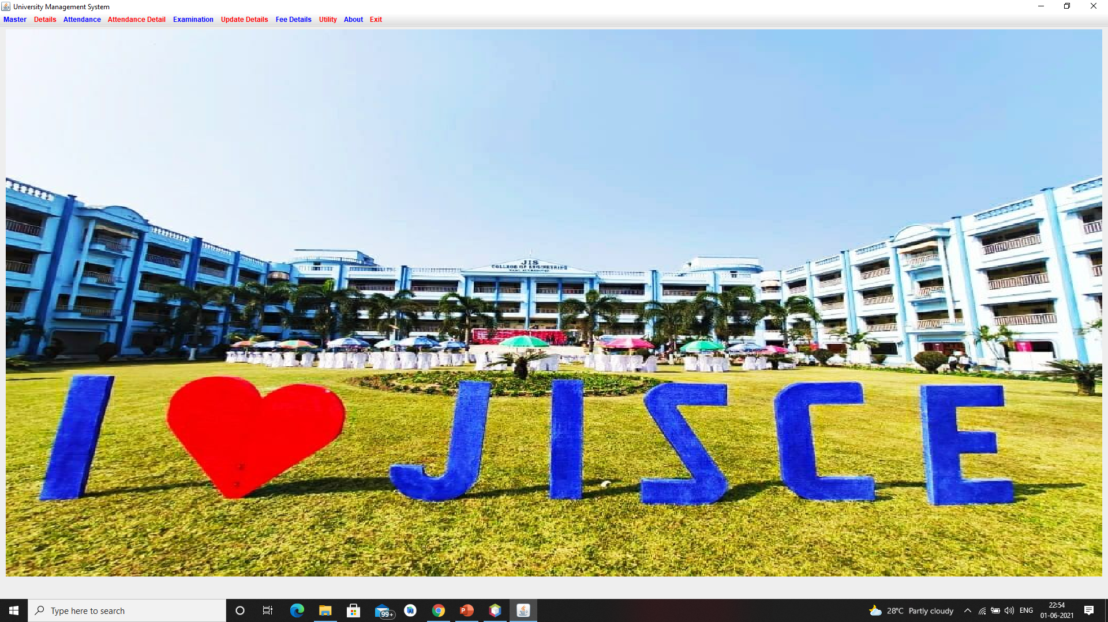
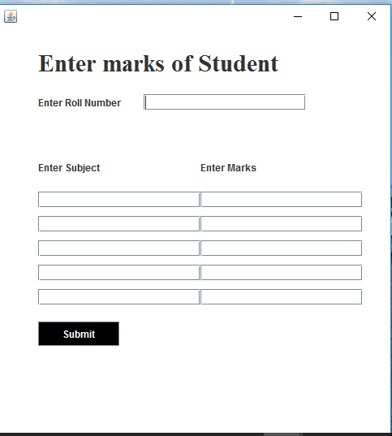
Snapshots

Slide 18
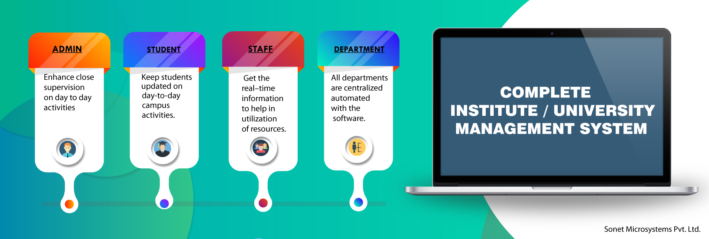
CONCLUTION
This project is successfully implemented with all the features mentioned in system requirements specification.
The application provides appropriate information to users according to the chosen service.
The project is designed keeping in view the day to day problems faced by a college.
Deployment of our application will certainly help the college to reduce unnecessary wastage of time in personally going to each department for some information.

Slide 19


Future Enhancement:
Online examination module would be introduced to conduct online examination.
Scheduling of the staff. i.e. , time table setting of the staff
Further, the faculty can upload the videos of their lectures on to this site and students who had missed those classes can view those videos.

Slide 20
Thank You

